Slide 1
October 2021
SEO REPORT
https://www.yourclientswebsite.com

Slide 2
Highlights
Search visibility is +0.14 MoM, which is an 8% increase.
Organic sales conversions increased by 117% MoM to 78 in total.
Got great backlinks from Forbes, The Verge, and NBC News.
Approaching the final stage of fixing technical SEO issues. Only some minor issues with hreflang remain. Those are assigned to your dev team.

Slide 3
SEO KPIs

Slide 4
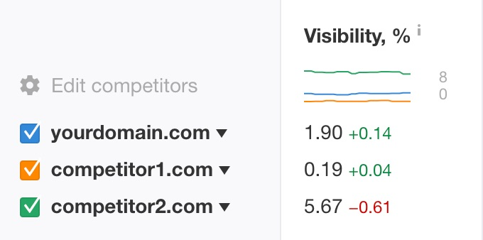
Progress of search visibility + conversions
While our organic traffic hasn't skyrocketed, organic (and other) conversions did. We have more organic traffic to high-value pages. But most of this should be attributed to the recent UX and CRO updates on the website.

Slide 5
Organic traffic metrics

Slide 6
Ranking progress per keyword segments
Biggest winner is [keyword segment 1], where we've got some of the keywords to jump from #2 or #3 to position #1.
There isn’t an actual drop for [keyword segment 5]. The drop in visibility is due to the addition of more important keywords that we didn't track before, so the visibility metric is now more diluted.

Slide 7
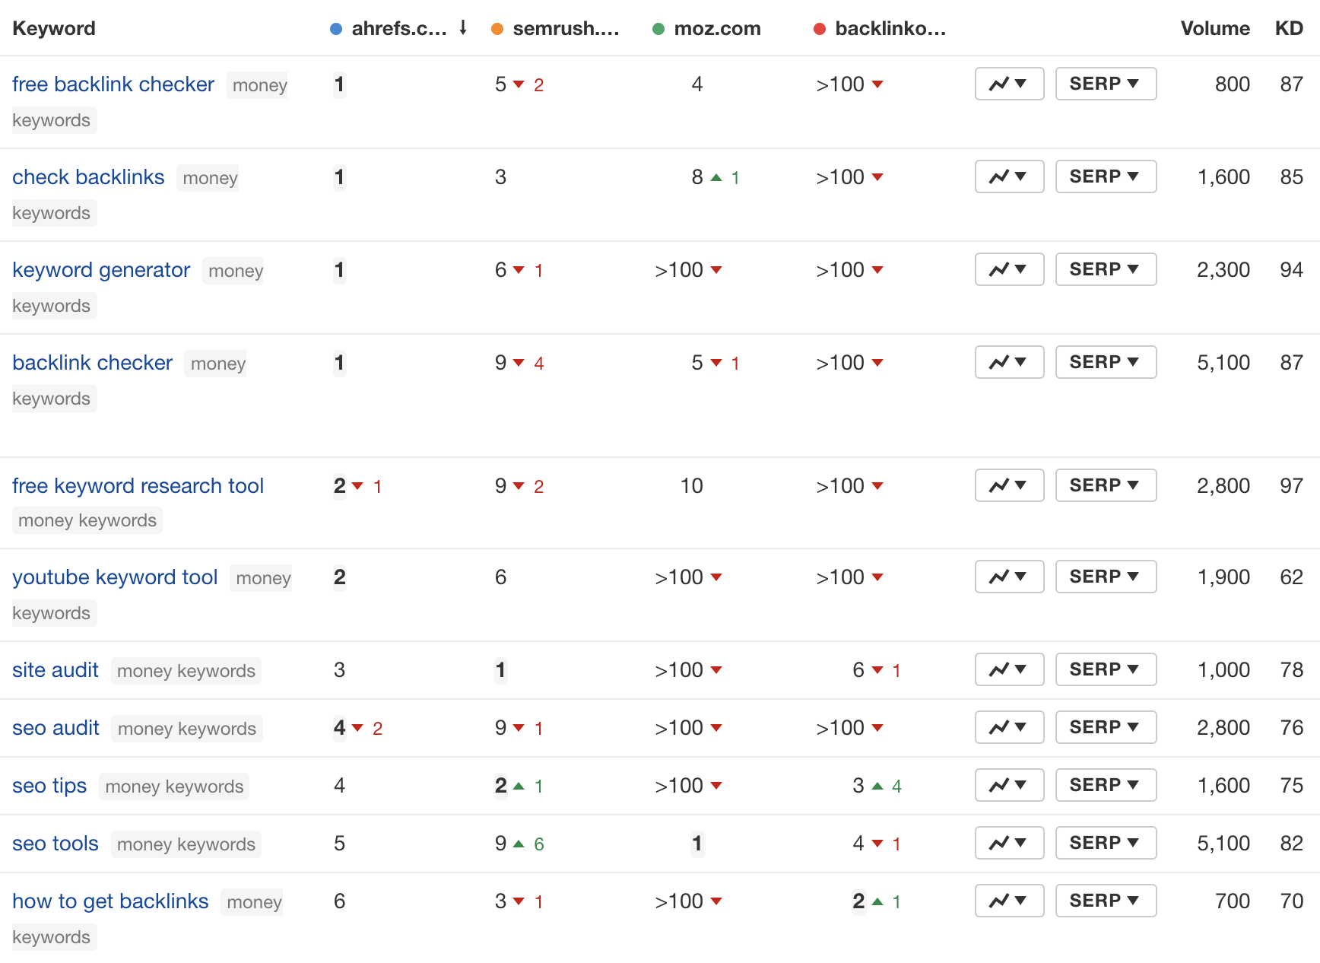
Money keywords ranking overview
Our top positions remain fairly stable. Competition hasn’t done that well.
[comments about significant keyword changes]
[link to Ahrefs or spreadsheet with the whole report]

Slide 8
Non-branded organic traffic progress
MoM
Not a big change in the absolute metrics MoM. But we're doing better for the most important keywords, as seen before.
YoY
Google's push of zero-click SERPs diminishes our much better search visibility YoY. It's still good to be present on the SERPs even if we don't get that many clicks, though.

Slide 9
Backlink growth

Slide 10
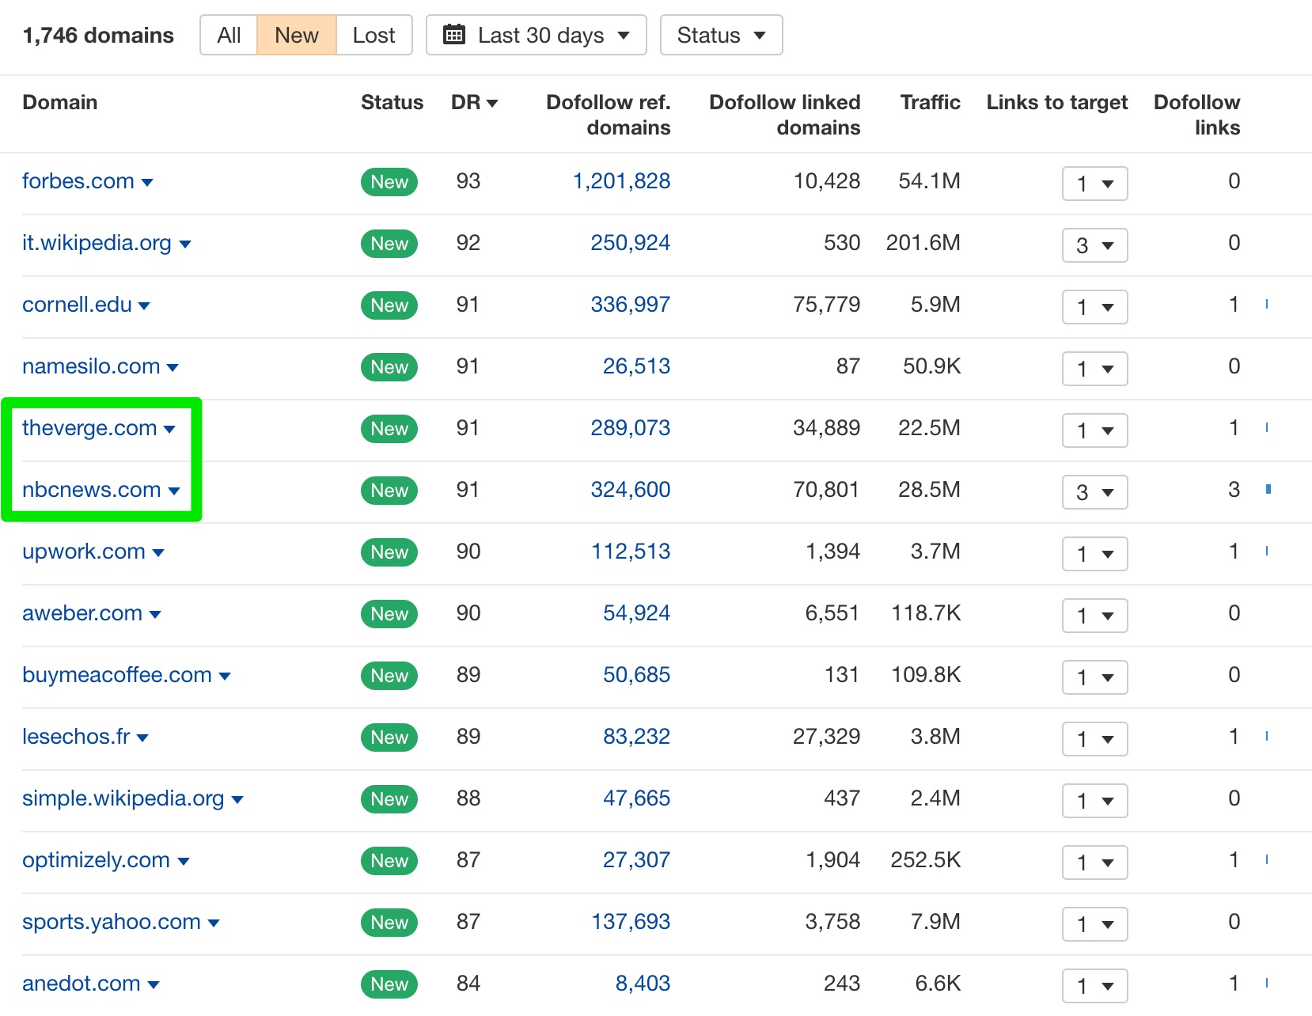
New referring domains highlights
Green highlights links from our link building and PR campaign.
The rest is the snowball/flywheel effect of having great content.

Slide 11
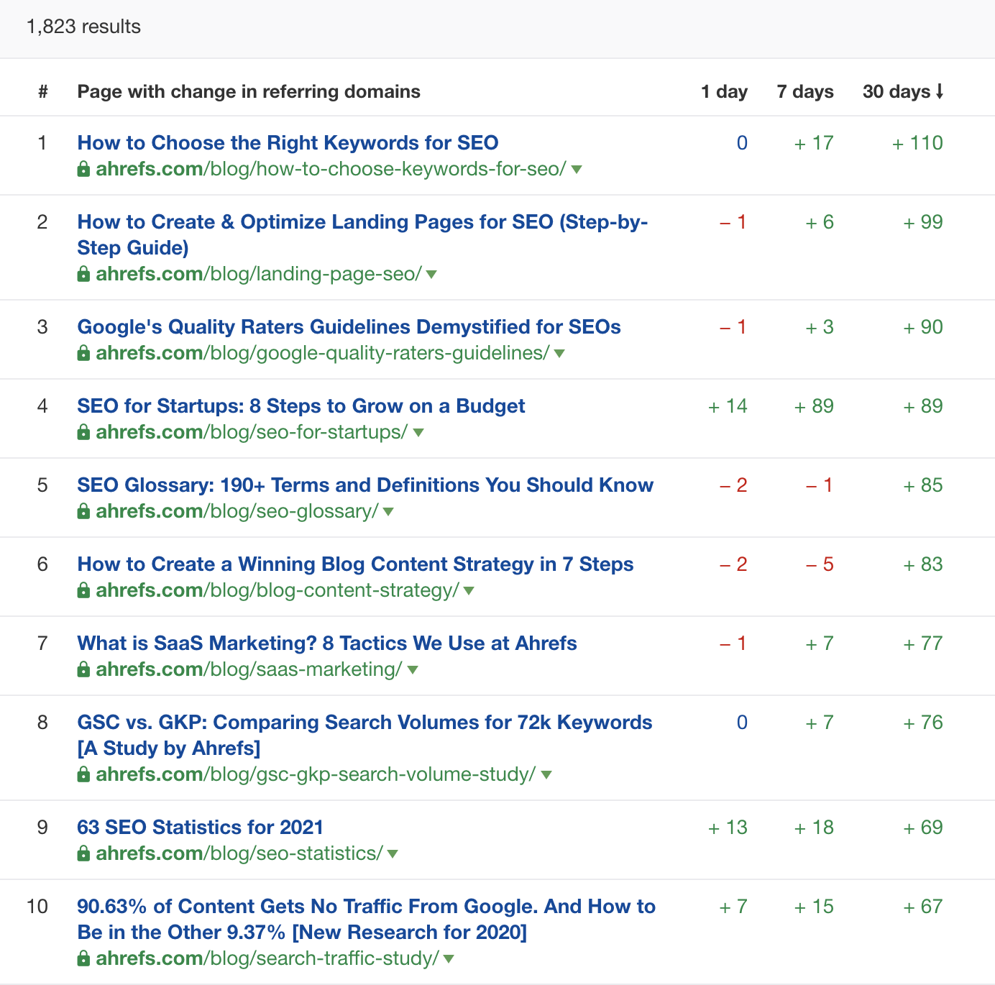
Link building progress
We've been building links to pages #1, #4, and #7 here. Outreach campaigns were successful, as these pages got to the top of the ‘Best by links’ growth report.
Link prospects contacted: 922
Links acquired: 129
Success rate: 14% (very high in link building)

Slide 12
SEO health overview

Slide 13
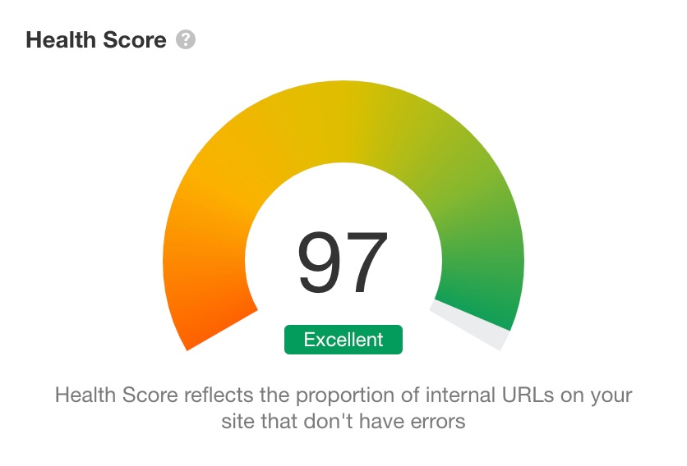
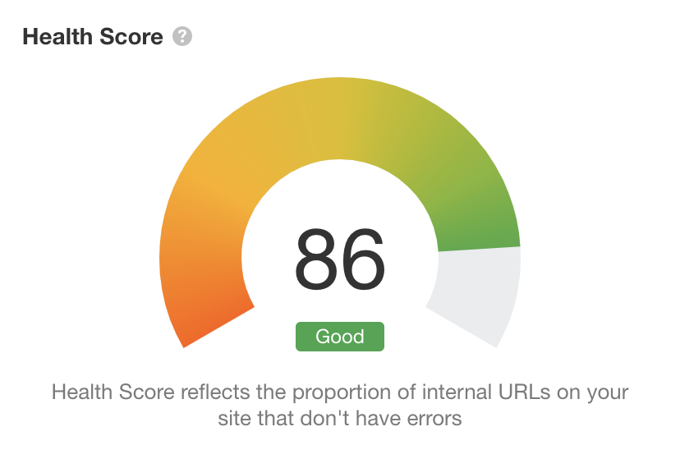
Technical SEO health overview
This month
Last month
We're getting close to a perfect score. The remaining errors are mostly regarding the hreflang problem, which is being dealt with.

Slide 14
Next month

Slide 15
Next month
Launch a link building campaign around the new and free online tool we've been developing.
Audit and optimize content to get more featured snippets. We currently get ~8% of all FS available for keywords we rank for on the first SERP, while Competitor 1 gets ~13%. This is a good traffic growth opportunity.
Work on improving Largest Contentful Paint (LCP)—the only Core Web Vitals metric we can still quite easily improve.

